Slide 1


Computer Architecture Spring 2020
Hamed Farbeh
farbeh@aut.ac.ir
Department of Computer Engineering
Amirkabir University of Technology

Slide 2
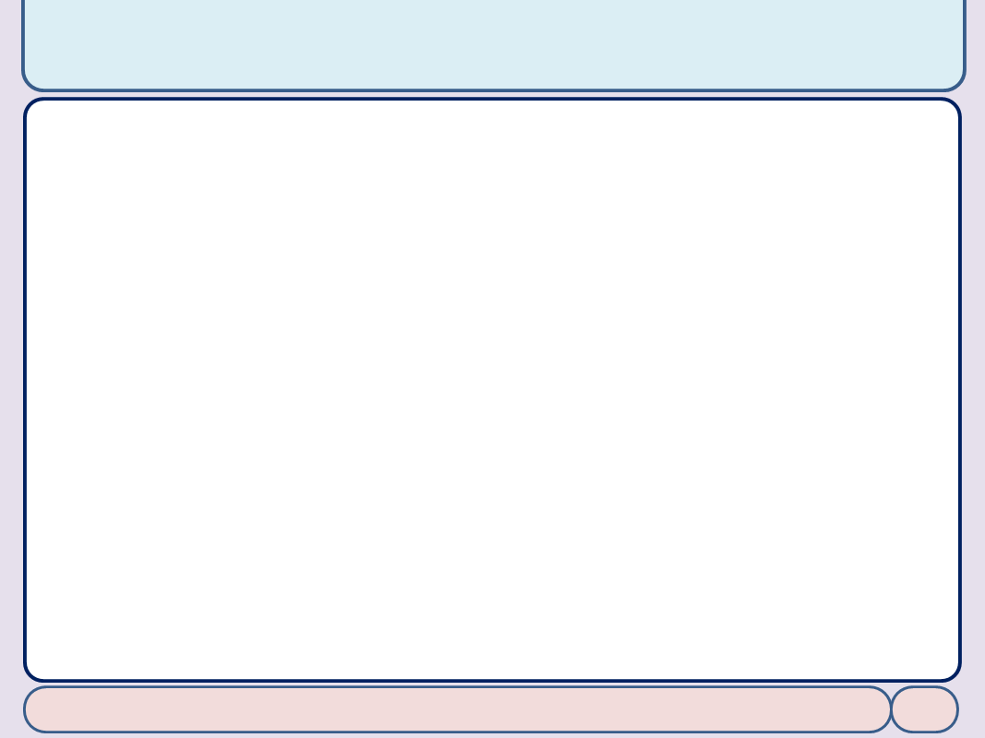

Copyright Notice
Lectures adopted from
Computer Organization and Design: The Hardware/Software Interface, 5th edition, David A. Patterson, John L. Hennessy, MK pub., 2014
Chapter 3: Arithmetic for Computers
Computer Architecture, Spring 2020, AUT, Tehran, Iran

Slide 3
Chapter 3
Arithmetic for Computers

Slide 4
Floating Point
§3.5 Floating Point
Representation for non-integral numbers
Including very small and very large numbers
Like scientific notation
–2.34 × 10⁵⁶
+0.002 × 10^{–4}
+987.02 × 10⁹
In binary
±1.xxxxxxx₂ × 2^{yyyy}
Types float and double in C
normalized
not normalized

Slide 5
Floating Point Standard
Defined by IEEE Std 754-1985
Developed in response to divergence of representations
Portability issues for scientific code
Now almost universally adopted
Two representations
Single precision (32-bit)
Double precision (64-bit)

Slide 6
IEEE Floating-Point Format
single: 8 bits double: 11 bits
single: 23 bits double: 52 bits
S
Exponent
Fraction
S: sign bit (0 ⇒ non-negative, 1 ⇒ negative)
Normalize significand: 1.0 ≤ |significand| < 2.0
Always has a leading pre-binary-point 1 bit, so no need to represent it explicitly (hidden bit)
Significand is Fraction with the “1.” restored (Unsigned)
Exponent: excess representation: actual exponent + Bias
Ensures exponent is unsigned
Single: Bias = 127; Double: Bias = 1023 Bias = (2^{E-1}-1)

Slide 7
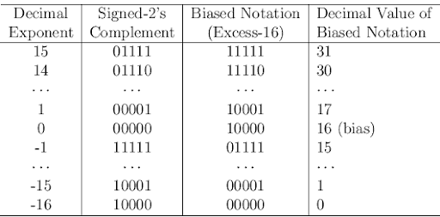
Biased Exponent

Slide 8
Single-Precision Range
Exponents 00000000 and 11111111 reserved
Smallest value
Exponent: 00000001 ⇒ actual exponent = 1 – 127 = –126
Fraction: 000…00 ⇒ significand = 1.0
±1.0 × 2^{–126} ≈ ±1.2 × 10^{–38}
Largest value
exponent: 11111110 ⇒ actual exponent = 254 – 127 = +127
Fraction: 111…11 ⇒ significand ≈ 2.0
±2.0 × 2⁺¹²⁷ ≈ ±3.4 × 10⁺³⁸

Slide 9
Double-Precision Range
Exponents 0000…00 and 1111…11 reserved
Smallest value
Exponent: 00000000001 ⇒ actual exponent = 1 – 1023 = –1022
Fraction: 000…00 ⇒ significand = 1.0
±1.0 × 2^{–1022} ≈ ±2.2 × 10^{–308}
Largest value
Exponent: 11111111110 ⇒ actual exponent = 2046 – 1023 = +1023
Fraction: 111…11 ⇒ significand ≈ 2.0
±2.0 × 2⁺¹⁰²³ ≈ ±1.8 × 10⁺³⁰⁸

Slide 10
Floating-Point Precision
Relative precision
all fraction bits are significant
Single: approx 2^{–23}
Equivalent to 23 × log₁₀2 ≈ 23 × 0.3 ≈ 6 decimal digits of precision
Double: approx 2^{–52}
Equivalent to 52 × log₁₀2 ≈ 52 × 0.3 ≈ 16 decimal digits of precision

Slide 11
Floating-Point Example
Represent –0.75
–0.75 = (–1)¹ × 1.1₂ × 2^{–1}
S = 1
Fraction = 1000…00₂
Exponent = –1 + Bias
Single: –1 + 127 = 126 = 01111110₂
Double: –1 + 1023 = 1022 = 01111111110₂
Single: 1011111101000…00
Double: 1011111111101000…00

Slide 12
Floating-Point Example
What number is represented by the single-precision float
11000000101000…00
S = 1
Fraction = 01000…00₂
Exponent = 10000001₂ = 129
x = (–1)¹ × (1 + 01₂) × 2^{(129 – 127)}
= (–1) × 1.25 × 2²
= –5.0

Slide 13
Denormal Numbers
Exponent = 000...0 ⇒ hidden bit is 0
Smaller than normal numbers
allow for gradual underflow, with diminishing precision
Denormal with fraction = 000...0
Two representations of 0.0!

Slide 14
Infinities and NaNs
Exponent = 111...1, Fraction = 000...0
±Infinity
Can be used in subsequent calculations, avoiding need for overflow check
Exponent = 111...1, Fraction ≠ 000...0
Not-a-Number (NaN)
Indicates illegal or undefined result
e.g., 0.0 / 0.0
Can be used in subsequent calculations

Slide 15
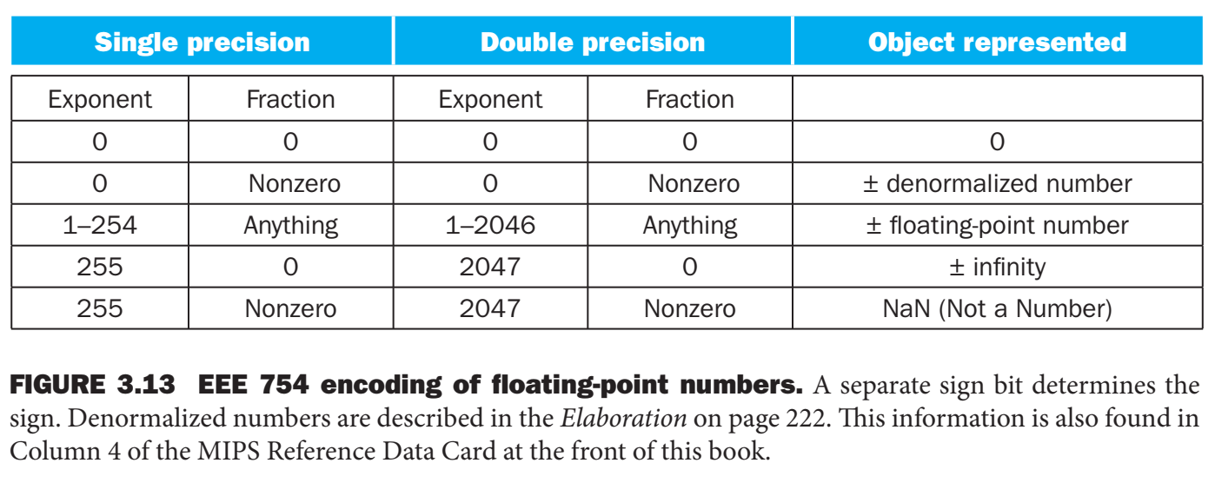

Slide 16
